Slide 1
Reverse Car parking using arduino
Project by:
Goutam choudhary
Yash Gupta

Slide 2
Content
Reason to build this project
Equipment
Component
Concept
Diagram
The process
Arduino code
Future plan
Conclusion

Slide 3
Reasons to build this project
Help people to park car in reverse direction
Using ultrasonic sensor for more efficiency
Save people’s time
Decrease the difficulties to park in reverse direction
Help to avoid collision

Slide 4
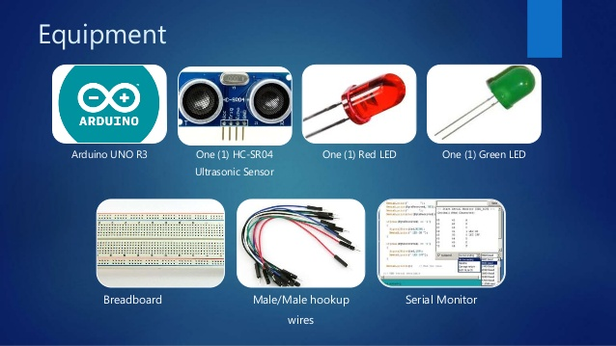
Equipment

Slide 5
Component
Arduino UNO [Buy Here]
HC-SR04 Ultrasonic Sensor
BC548 NPN Transistor (any NPN Transistor can be used)
5V Buzzer
1N4007 PN Junction Diode
1KΩ Resistor (1/4 Watt)
Mini Breadboard
Connecting Wires
5V Power Supply

Slide 6
Concept
Arduino UNO R3:
Arduino/Genuino UNO is a microcontroller board. It has 14 digital input/output pins, 6 analog inputs, a 16 MHz quartz crystal, a USB connection a power jack, an ICSP header and a reset button.
HC-SR04:
The HC-Sr04 is an excellent low-cost ultrasonic sensor that works well with Arduino micro-controllers. It will help to find the distance with ultrasonic sound.

Slide 7
The process:
First connect the VCC and GND pins to the Arduino’s +5v and GND pins.
Next connect the Trigger and Echo pins to two digital pins on the Arduino, perhaps pins 2 and 3 for example
Setting the Trigger pin to HIGH for 10 microseconds will activate a measurement reading and then the Plusein() function can be caleed on the Echo pin to determine the distance.

Slide 8
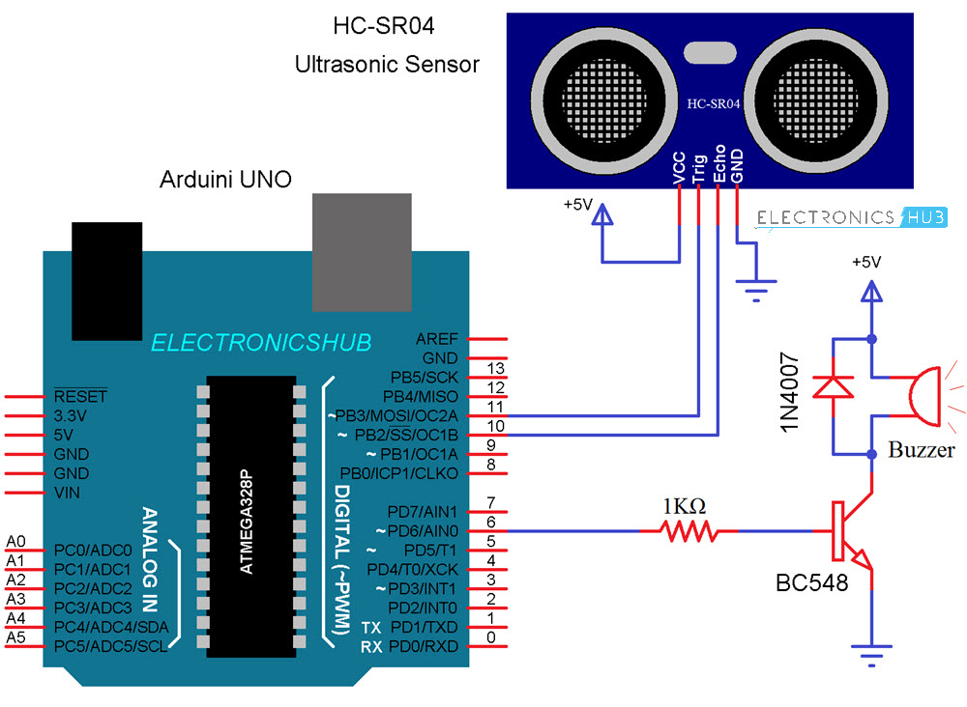
Daigram

Slide 9
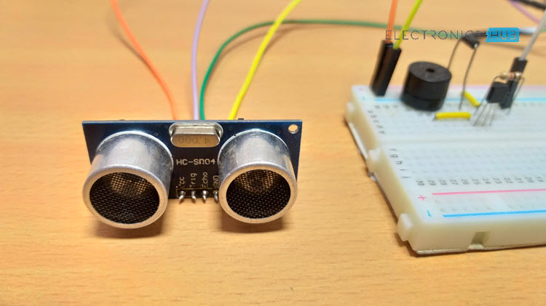
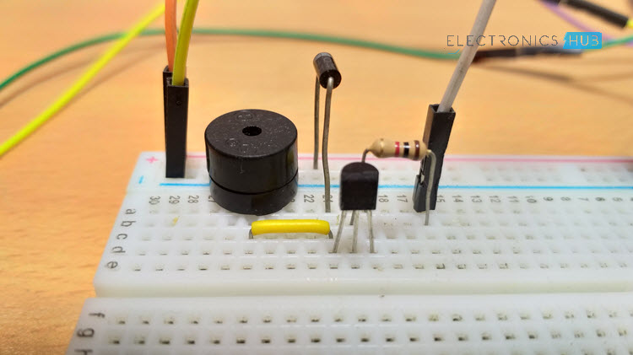
Diagram

Slide 10
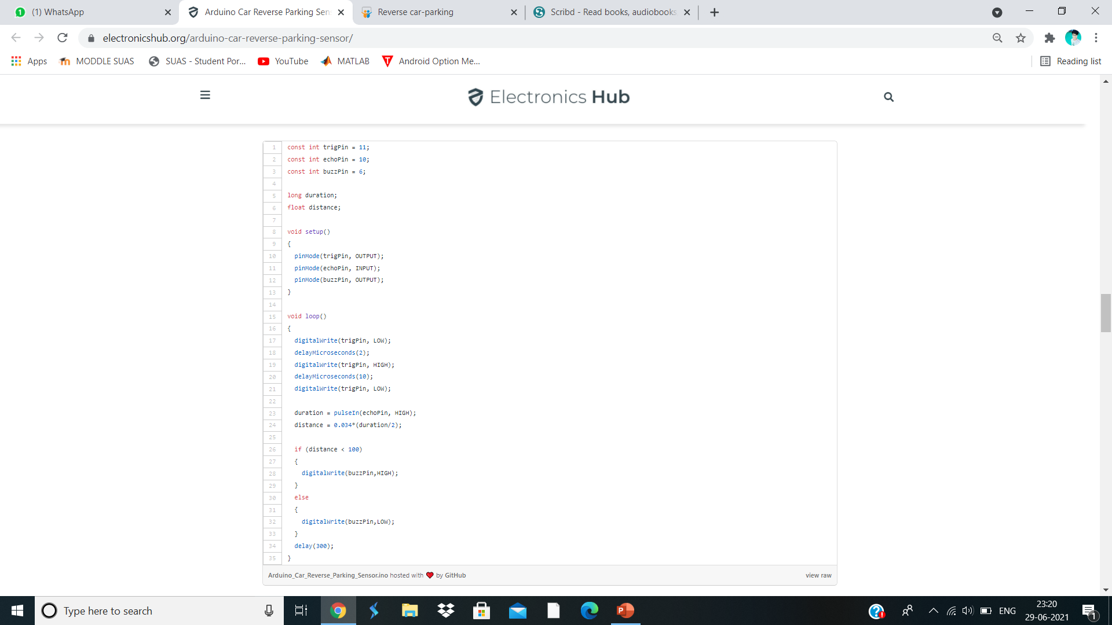
Arduino code

Slide 11
Future plan
Using it in Robots
Making it available for all types of vehical
Using serval sensor to get proper reading around the whole car not in just reverse direction.
Automatic Car parking
Effective implementation on Intelligent Parking Assist System (IPAS), also known as the Advanced Parking Guidance System(APGS)

Slide 12
Conclusion
Operation have been discussed.
The purpose of Arduino is discussed,
Future plan and its application are discussed.
Equipment and the process of this project is discussed.

Slide 13
THAnkYOU

